Slide 1
Overview of MongoDB

Slide 2
Contents
Overview of MongoDB
Getting started with MongoDB
Annex
Installing MongoDB

Slide 3
1. Overview of MongoDB
What is MongoDB?
Key features of MongoDB
Hosting vs. local installation
MongoDB editions

Slide 4
What is MongoDB?
MongoDB is an open-source document database
In MongoDB, a document is a BSON object ("binary JSON")
A document contains fieldname/value pairs
Values can be simple types, arrays, or nested documents
Here's an example of a MongoDB document:
{
name: "Sam",
age: 21,
skills: [ "Java", "C++", "JavaScript" ],
additionalInfo: {
nationality: "UK",
companyCar: {
make: 'Bugatti',
model: 'Chiron'
}
}
}

Slide 5
Key Features of MongoDB
High performance
Via indexes
Rich query language for CRUD operations
Data aggregation
Text search and geospatial queries
High availability
Via automatic failover and data redundancy
Horizontal scalability across a cluster
Via sharding

Slide 6
Hosting vs. Local Installation
You can either host MongoDB in the cloud, or install locally
Hosting MongoDB in the cloud…
MongoDB Atlas is a cloud-hosted service
Allows you to provision, run, monitor and maintain MongoDB
Fast, free, and an easy way to get started with MongoDB
For details, see https://www.mongodb.com/cloud
Installing MongoDB locally…
Some organizations prefer to install MongoDB on their own servers
E.g. for historical or governance reasons
Many platforms supported, including Unix, Mac, Windows, etc.
For details, see https://docs.mongodb.com/manual/installation/

Slide 7
MongoDB Editions
MongoDB Community Edition
Free, standalone NoSQL database engine
We'll use this
MongoDB Enterprise Edition
Monthly or annual fee, per server
Advanced security features, integration options, production support

Slide 8
2. Getting Started with MongoDB
Downloading and installing MongoDB
Starting MongoDB from the Command Line
Starting MongoDB as a Windows Service
Using the MongoDB interactive shell
Using MongoDB Compass

Slide 9
Downloading and Installing MongoDB
You can install MongoDB Community Edition for free
For details, see the Annex at the end of this chapter
We've already installed MongoDB Community Edition
See C:\Program Files\MongoDB\Server\3.6

Slide 10
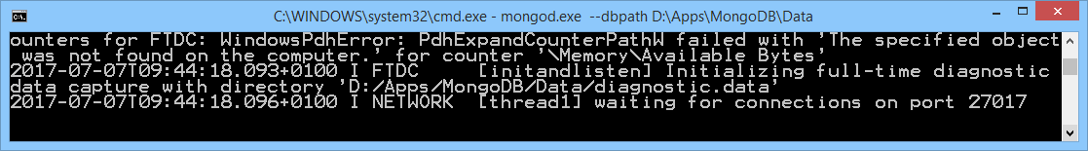
Starting MongoDB from the Command Line
MongoDB requires a data directory to store all data
The default data directory path is the absolute path \data\db on the drive from which you start MongoDB
You must create this data directory on your system
You can then run MongoDB from the Command Line
At the Command Line, go to the MongoDB bin folder
Run the following command, optionally specifying a data directory
All being well, you'll see the following message:
mongod.exe --dbpath C:\data\db

Slide 11
Starting MongoDB as a Windows Service
The previous slide described how to start MongoDB from the Command Line
Handy for testing, and during development
It's also possible to install MongoDB as a Windows Service
MongoDB starts automatically when the machine boots up
Preferable in a production environment
For info on how to start MongoDB as a Windows Service
See the Annex at the end of this chapter, and also see… https://docs.mongodb.com/manual/tutorial/install-mongodb-on-windows/#manually-create-a-windows-service-for-mongodb-community-edition

Slide 12
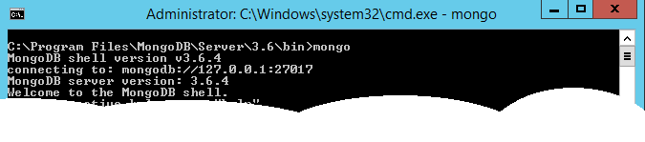
Using the MongoDB Interactive Shell
You can interact with a running MongoDB instance via the MongoDB interactive shell
Enables you to enter simple MongoDB CRUD commands
To start a MongoDB shell:
Open a new Command Prompt window
Go to the MongoDB bin folder and run the following command
All being well, you'll see the following message:
mongo

Slide 13
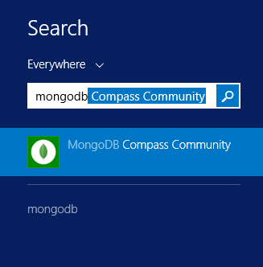
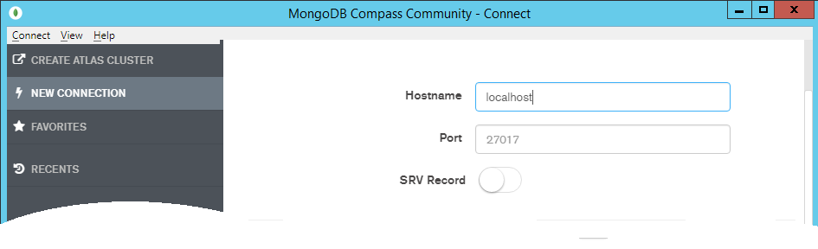
Using MongoDB Compass (1 of 2)
You can also interact with a running MongoDB instance by using MongoDB Compass
This is the official IDE for MongoDB
Run MongoDB Compass and connect to the MongoDB instance on localhost, port 27017

Slide 14
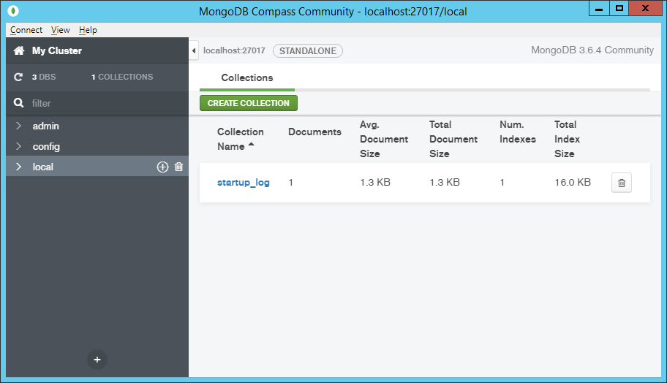
Using MongoDB Compass (2 of 2)
MongoDB Compass allows you to explore and manage data in your MongoDB instance

Slide 15
Any Questions?

Slide 16
Annex: Installing MongoDB
Downloading MongoDB for Windows
Installing MongoDB for Windows
MongoDB installation options

Slide 17
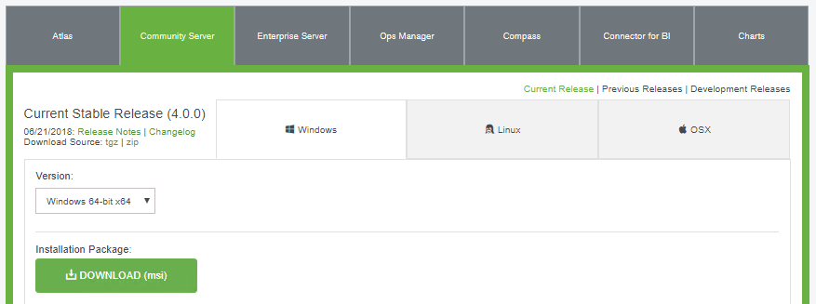
Downloading MongoDB for Windows
This section shows how to install MongoDB Community Edition on Windows…
Requires Windows Server 2008 R2, Windows Vista, or later
Go to the download page for MongoDB Community Edition
https://www.mongodb.com/download-center#community
Select the Windows 64-bit installation
1
2
3
4

Slide 18
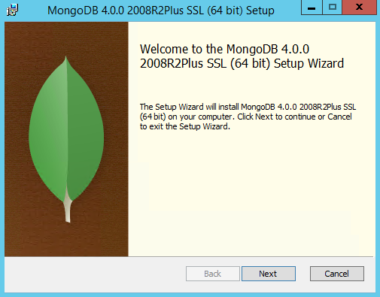
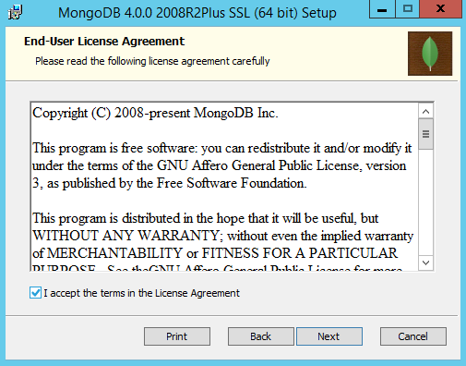
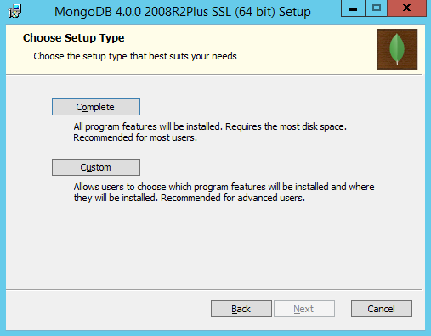
Installing MongoDB for Windows
When the MongoDB msi has downloaded, run it

Slide 19
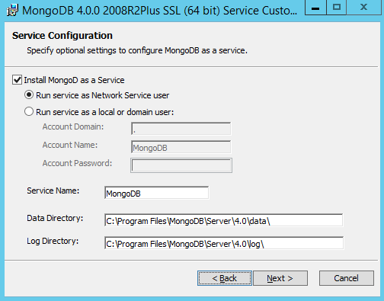
MongoDB Installation Options (1 of 3)
It's possible to install MongoDB as a Windows Service
MongoDB starts automatically when the machine boots up
MongoDB requires a data directory to store all data
You can accept the default location, or specify a different location

Slide 20
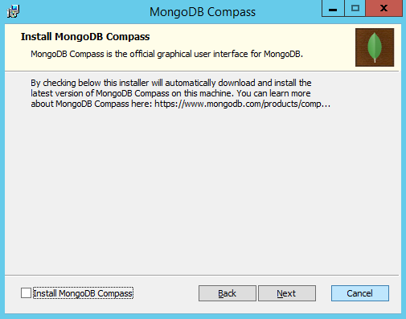
MongoDB Installation Options (2 of 3)
You can choose to install MongoDB Compass
The official IDE for managing MongoDB
Deselect this option if Compass is already installed, or if you want to install it later

Slide 21
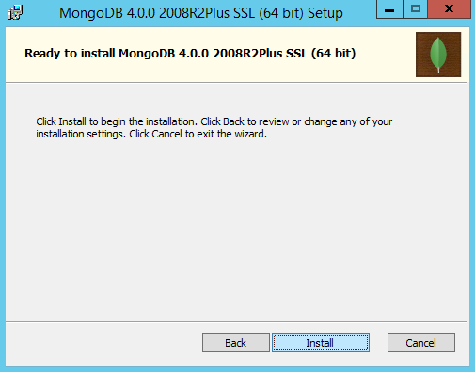
MongoDB Installation Options (3 of 3)
Proceed to begin the installation

